Slide 1


Python Any Where
DTI Project

Slide 2
Introduction to PAW
Welcome to Python Anywhere - Your Free Python Learning Resource! Are you eager to learn Python, one of the most versatile and widely-used programming languages in the world? Look no further! Python Anywhere is your go to destination for Python education, and the best part? No login or registration required. We believe in making Python learning accessible to everyone, like a free bird soaring in the open sky.
Why Python Anywhere? Video Tutorials: Our library of video tutorials covers Python from the basics to advanced topics. Learn at your own pace, pause, rewind, and watch as many times as you need.
Real-World Examples: We understand that Python becomes more meaningful when you see it in action. That's why we provide real-world code examples that help you grasp concepts faster.
No Barriers: Forget about tedious sign-up processes or membership fees. Python Anywhere is open to all, from beginners to experienced programmers, without any restrictions.
Interactive Coding: Practice what you learn with our interactive coding platform. Write and run Python code right on the website, and see the results instantly.
Start Your Python Journey Today Whether you're looking to kickstart your programming career, enhance your skills, or simply explore the world of Python, Python Anywhere is the perfect place to begin. We believe that Python should be accessible to everyone, and that's why we've created a no-barriers platform for your learning pleasure. So, what are you waiting for? Dive into the fascinating world of Python with Python Anywhere. Let's spread the wings of knowledge together! Feel free to use this introduction as a starting point for your website, and customize it further to fit your vision and mission for Python Anywhere. Happy coding!

Slide 3
Abstract
Python Anywhere is an innovative online platform dedicated to simplifying the process of learning Python programming. With a commitment to accessibility and excellence, Python Anywhere offers free, unrestricted access to a wealth of Python learning resources.
Our platform boasts a comprehensive library of video tutorials, supported by real world examples, ensuring that learners can grasp Python's intricacies with ease. What sets Python Anywhere apart is its dedication to interactivity; users can practice their skills on the site's interactive coding platform, gaining hands-on experience and immediate feedback.
Community engagement is at the heart of Python Anywhere. Join a vibrant network of Python enthusiasts, ask questions, and share knowledge to enhance your learning journey. Our content remains current, keeping pace with the ever-evolving Python ecosystem.

Slide 4
Existing System
Before the inception of "Python Anywhere," aspiring Python learners had limited options for structured online education. The existing landscape consisted of scattered resources across various platforms, including YouTube tutorials, text-based documentation, and a few online courses. This fragmented approach often left learners feeling overwhelmed and lacking a clear path to mastering Python. Challenges of the Existing System
1. Fragmented Learning: Learners had to navigate multiple platforms and sources to access Python tutorials and quizzes, leading to a disjointed learning experience.
2. Quality Variation: The quality of available Python tutorials varied widely, making it difficult for learners to distinguish between reliable and subpar resources.
3. Lack of Interactivity: The existing system lacked interactive elements such as quizzes or exercises, making it harder for learners to apply their knowledge and track their progress.

Slide 5
LIMITATIONS OF THE EXISTING SYSTEMS
Cost and Restrictions: The existing system might have subscription fees, limited free access, or other restrictions that could discourage some users.
Ease of Use: The existing system may have a steeper learning curve or a less intuitive interface.
Interactive Learning: The existing system may lack interactive coding features, making it harder for users to apply what they've learned.
Accessibility: The existing system may require users to create accounts or pay for access, potentially creating barriers for beginners or those looking for free resources.

Slide 6
Proposed System
Introduction Python Anywhere is a groundbreaking platform designed to revolutionize the way people learn Python programming. With an integrated approach of video tutorials and interactive quizzes, Python Anywhere aims to provide a seamless and comprehensive learning experience.
Key Features:
1. Structured Learning Path: Python Anywhere offers a structured curriculum that takes learners from Python basics to advanced topics. This clear roadmap ensures learners build a solid foundation and progress methodically.
2. High-Quality Videos: The platform hosts high-quality video tutorials delivered by experienced Python instructors. These videos are designed to be engaging and informative, making complex concepts accessible to all.
3. Community Engagement: Python Anywhere fosters a supportive community of Python enthusiasts. Learners can interact with peers, ask questions, and collaborate on projects, creating a collaborative learning environment.
4. 24/7 Accessibility: Python Anywhere is accessible 24/7, allowing learners to study at their own pace, whenever and wherever they prefer.

Slide 7
Advantages of Python Anywhere
Streamlined Learning: Python Anywhere simplifies the learning process by offering a one-stop platform for Python education.
Consistency: Learners can trust Python Anywhere for consistently high-quality content and a structured learning path.
Engagement: The combination of videos and examples keeps learners engaged and actively involved in the learning process.
Community: Python Anywhere fosters a sense of community, providing learners with support and networking opportunities.
In conclusion, "Python Anywhere" represents a significant improvement over the fragmented existing system, offering a holistic and effective approach to learning Python through videos and quizzes. It empowers learners to build their Python skills systematically and interactively while being part of a supportive community.

Slide 8
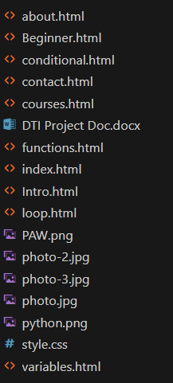
CONTENTS OF THE PROJECT:
Home Page:
The home page serves as the main landing page of your website. It provides an introduction to your website and its purpose. This page may include highlights of the courses offered, key features, and a call to action to encourage visitors to explore further.
About Page:
The About page offers more information about your website. It describes the website's mission, goals, and what users can expect to find. It might also include information about the creators or team behind the website.

Slide 9
CONTENTS OF THE PROJECT:
Courses: The Courses section of your website is where users can explore the different levels of Python courses offered. There are three levels:
Beginner Level: This course is designed for those who are new to Python programming. It may include topics like basic syntax, data types, and simple programming concepts.
Intermediate Level: The Intermediate course is for users with some Python experience. It covers more advanced topics such as functions, libraries, and data manipulation.
Advanced Level: The Advanced course is for experienced Python programmers. It delves into complex concepts like object-oriented programming, web development, and advanced data analysis.

Slide 10
CONTENTS OF THE PROJECT:
Contact Page:
The Contact page provides users with a way to get in touch with your website. It typically includes a contact form or a visible email address where users can send inquiries, feedback, or questions.
This structure should give visitors a clear understanding of your website's purpose, the courses available, and how to reach out for further information. Of course, you can add additional details and design elements to make each page more engaging and informative.

Slide 11
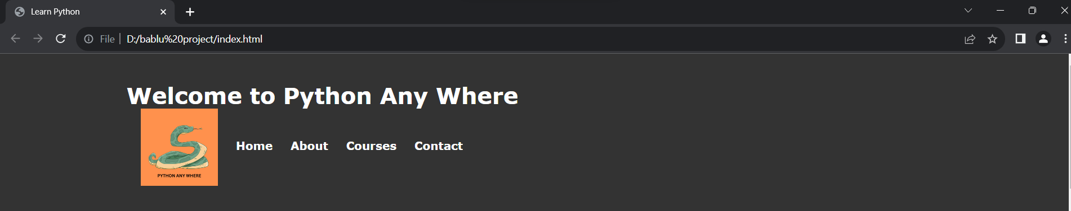
CONTENTS OF THE PROJECT:
Creating Seamless Web Navigation:
We harnessed the power of web routing to seamlessly connect every page of our website, ensuring a fluid and intuitive user experience. With a simple click, users can effortlessly explore various sections, making navigation a breeze.

Slide 12
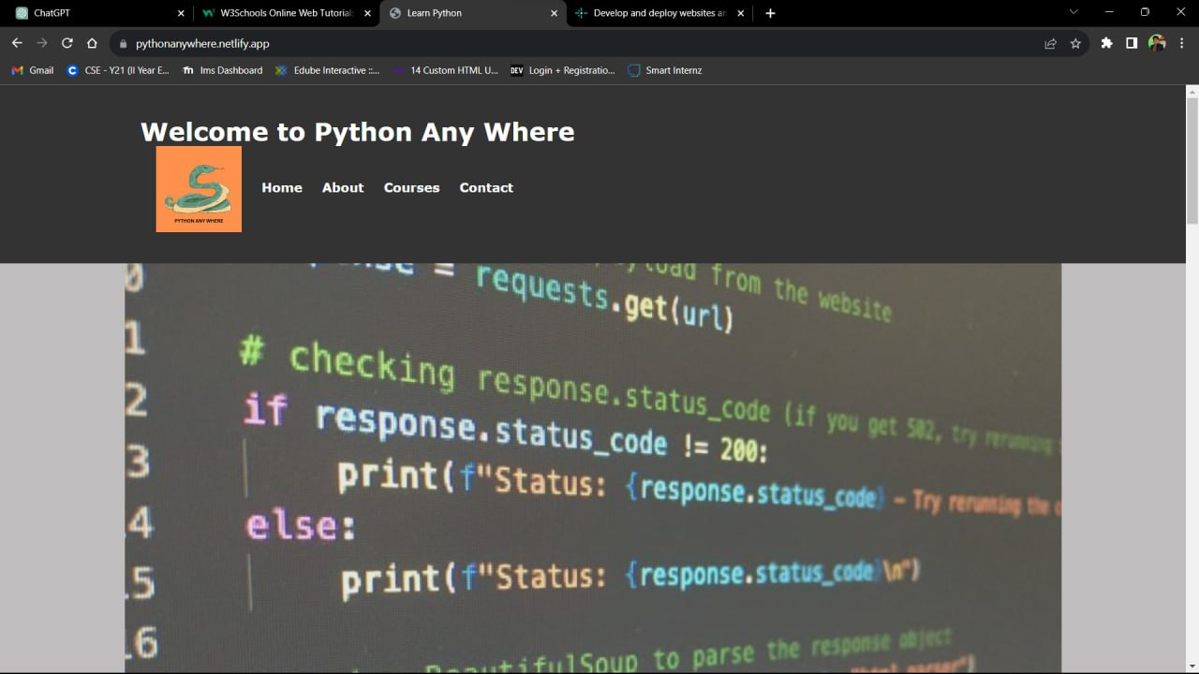
CONTENTS OF THE PROJECT:
Visual Impact with Stunning Imagery:
To captivate and engage our viewers, we didn't stop at just content. We've adorned our website with a curated collection of striking photos and visuals. Each image is carefully selected to create an aesthetically pleasing and visually impressive environment, enhancing the overall user experience.
Interactive Design for Engaging User Experience:
Our website isn't just a static platform; it's a dynamic and interactive space. We've designed it with you in mind, making it easy for you to interact, explore, and engage. You'll find interactive elements that respond to your actions, creating an immersive journey through our content.

Slide 13
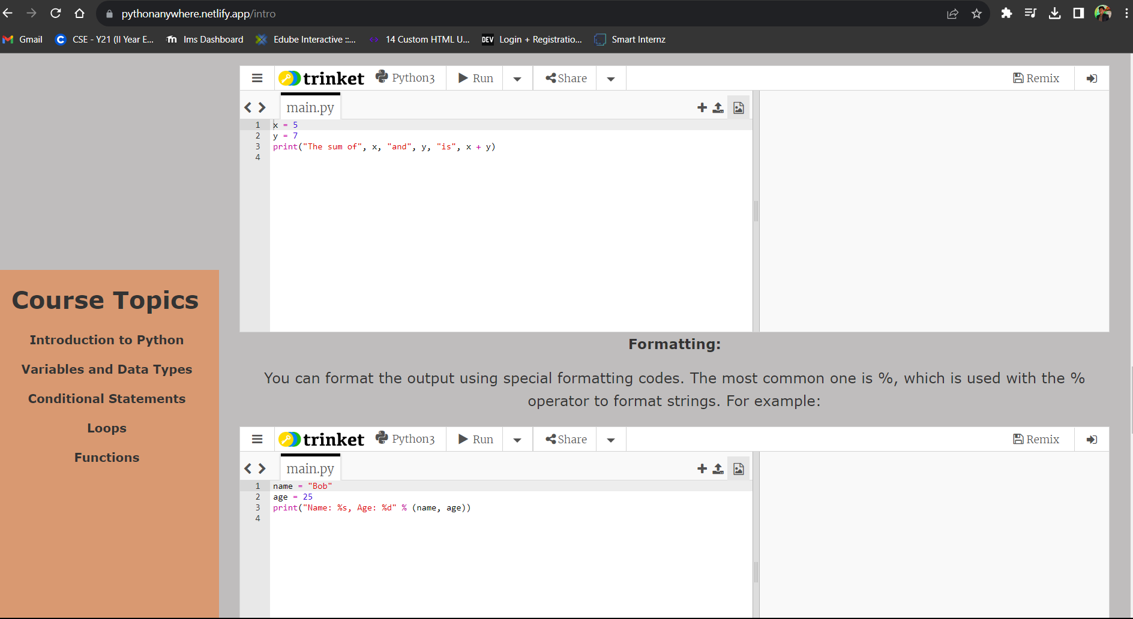
CONTENTS OF THE PROJECT:
Empowering Learning with Real-World Examples:
To ensure that our concepts are crystal clear and accessible to all, we've strategically placed real-world examples right in the heart of our content. These examples provide a tangible and practical understanding, making complex ideas easier to grasp. Learning becomes a hands-on experience, promoting better comprehension.
So, welcome to our website, where web routing, captivating imagery, and interactive design come together to create an impressive and user-friendly environment. Dive in and explore the world of knowledge and learning with ease!

Slide 14
CONTENTS OF THE PROJECT:
Taking Your Project to the World: Deploying on Netlify.com After crafting a stunning and interactive webpage, the next crucial step is to make it accessible to a global audience. We've entrusted this task to Netlify.com, a platform renowned for its seamless deployment and hosting capabilities.
Effortless Deployment: Netlify.com simplifies the deployment process. With just a few clicks, we were able to take our locally developed project and deploy it to the cloud. This means that our webpage, once confined to our local environment, is now accessible from anywhere in the world with an internet connection.
Global Accessibility: By hosting our webpage on Netlify, we've broken down geographical barriers. Whether you're in New York, Tokyo, or anywhere else on the planet, you can access our website without any hindrance. Netlify ensures low latency and fast loading times, ensuring a smooth experience for visitors worldwide.

Slide 15
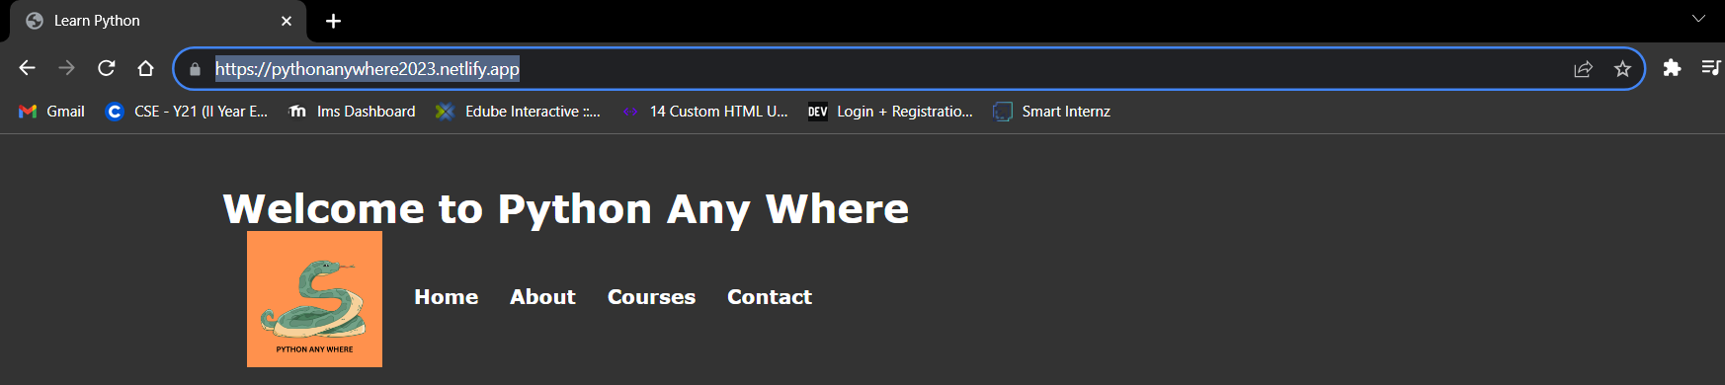
Our website link:
https://pythonanywhere2023.netlify.app/

Slide 16
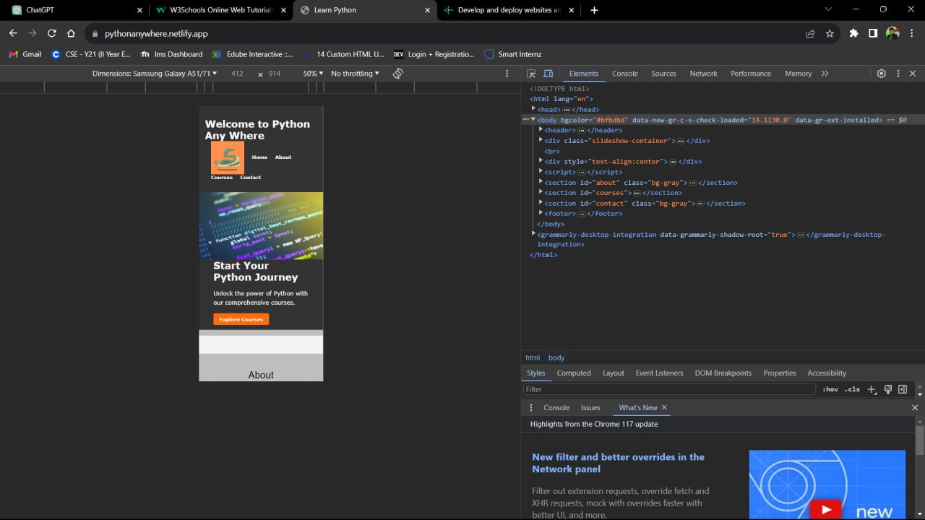
View Mode
Desktop Mode: Mobile Mode:

Slide 17
CONCLUSION
Python Anywhere is not just a website;
it's a gateway to the world of Python programming. With our commitment to accessibility, high-quality content, interactive learning, and a thriving community, we've created a platform that empowers learners of all levels to master Python. Whether you're a complete beginner or an experienced coder, Python Anywhere is your free ticket to explore, learn, and excel in Python programming. Join us today, and together, let's embark on an exciting journey of discovery and innovation through the power of Python."

Slide 18
REFERENCE
https://www.w3schools.com/
https://chat.openai.com/
https://www.youtube.com/results?search_query=jenny+lecture
https://www.netlify.com/

